Slide 1


AI in Unreal Engine 4 - 1
Advanced 3D Games Engines

Slide 2
Welcome
Key Goals:
Introduction to the basics of AI in games.
Look at different approaches to AI in games.
A generic look at Behaviour Trees.
How UE4 Implements Behaviour Trees.
How UE4 handles data to use with Behaviour Trees.
Run through a simple Path Node Example.

Slide 3
AI in Games
In games, AI is primarily used to create NPC behaviours that “should” exhibit human-like intelligence within the realms of the target simulation.
The techniques used typically draw upon existing methods from the field of Artificial Intelligence.
The span of complexity for AI in games is broad and can range from simple rule based systems to simulations that reflect the actions of a commander of an opposing army.
“The agent” refers to the thing in game that the AI is working for: Characters & Pawns typically.
When designing AI for games it is important to consider what is the best AI ?
The agent that maximises its chances of winning ?
The one that delivers the best entertainment value ?
The one that feels the most human?

Slide 4
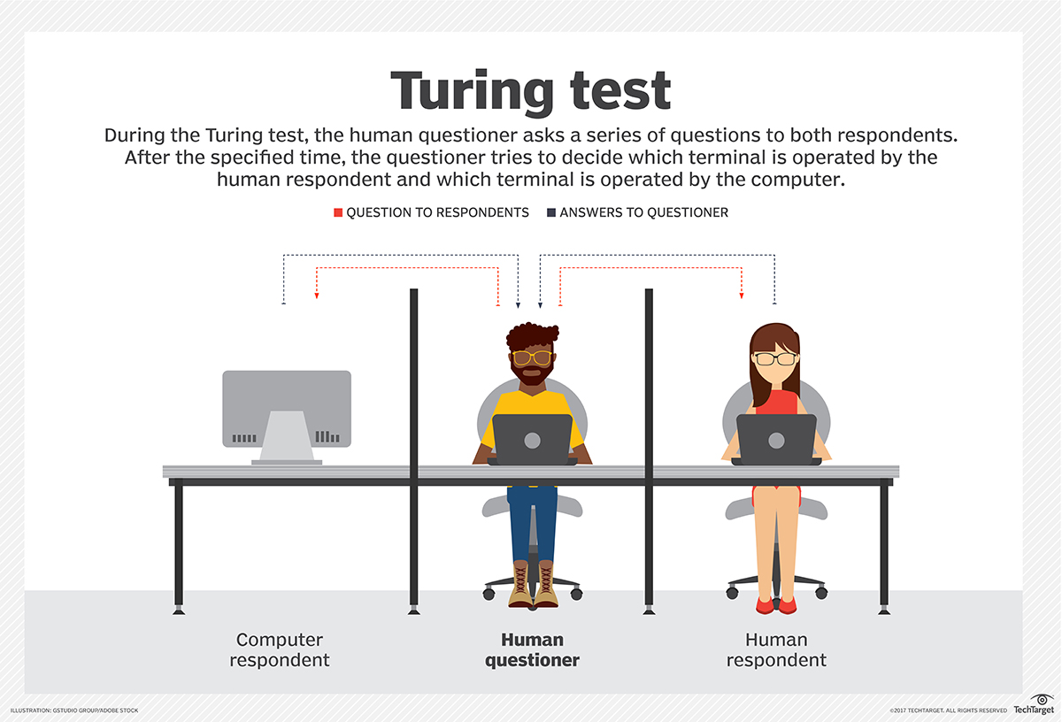
AI in Games
In 2004 (R. Le Hy et al.) published a paper that explored the idea of learning from skilled players how to react in a FPS game (Unreal Tournament), using a Bayesian Model (probability theory) and built using an approach similar to a traditional Finite State Machine.
The founding ‘test’ for checking if AI is considered to be indistinguishable from a human, is called the Turing Test
While the original test dealt with text conversation between 1 human and AI, it has been adapted to other areas, like games. It has been used for movement, accuracy, ‘smack talking’ humans and for game moderation.
Notes:
http://whatis.techtarget.com/definition/Turing-Test

Slide 5
Finite State Machines
State Machines are the most common approach for reactive behaviours in games as they are easily mastered, however do suffer when it comes to combined or parallel behaviours.
A finite-state machine, or FSM for short, is a model of computation based on a hypothetical machine made of one or more states.
For a standard FSM, only a single state can be active at any one time, so the machine must transition from one state to another in order to perform different actions.
FSMs are commonly used to organize and represent an execution flow, which is useful for implementing AI in games.
At some point you will all probably use / script your own state machines in some fashion.
Unreal Engine 4 and Unity uses them for their approaches to Animation and we’ve been using States within our Game Modes. However state machines are also suited to controlling certain types of AI.

Slide 6
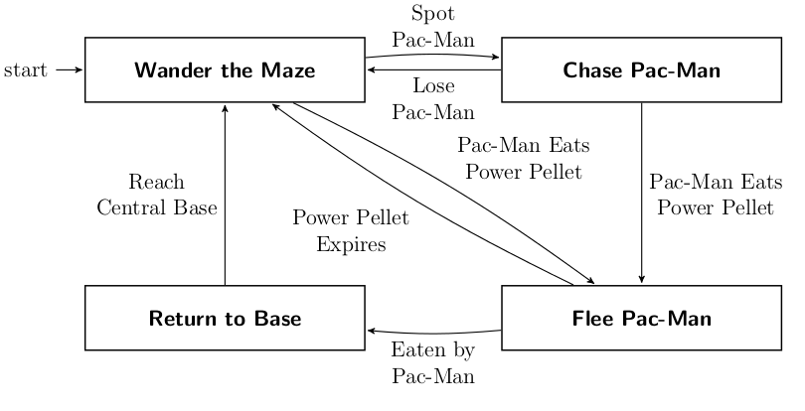
Finite State Machines
Example of a FSM:

Slide 7
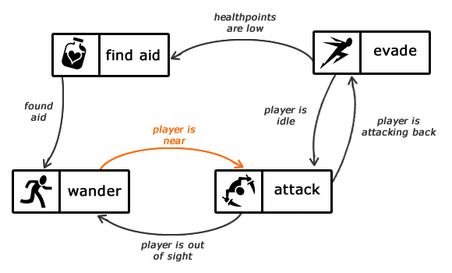
Finite State Machines
Example of a FSM:
Notes:
GENUINE HONDA CIVIC 1.8 PETROL CLUTCH KIT-2007-2011

Slide 8
Finite State Machines
It is very possible to set up a Finite State Machine within UE4.
You will need to set up:
States – These are usually Events, but can be separate own classes entirely.
Transitions – This is how control is passed between States. Uses the “Go To” statement.
Update – This is how we call the Machine to update its code. This is normally created in UE4 using a Timer, as it gives control over update frequency.
The approach:
Every update the current State runs its code.
Each States code contains branching logic as to which state to “Go To” on the next update (this can be itself).
It is even possible to create a Concurrent / Stack based state machines, which execute more than one state at a time.

Slide 9
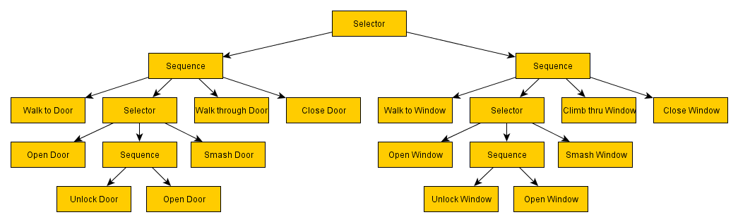
Behaviour Trees
Unlike a Finite State Machine, or many other systems used for AI programming, a behaviour tree is a tree of hierarchical nodes that control the flow of decision making of an AI entity.
They are event driven, which means they’re much easier to control compared to a FSM
At the very extents of the tree are the leaves, or leaf nodes. These are commands that directly control the AI entity.
Between the root and the leaves are various types of utility nodes (branches) that control flow towards the leaf nodes.

Slide 10
Behaviour Trees
The strength of behaviour trees over FSM’s is that development is particularly modular. The same code can easily be reused in other areas of the tree.
This is because branches are completely independent of each other.
Basic behaviours can be created and tested, with additional branches added over time.
Eventually, these branches can even be ordered by desirability, allowing for fall-back tactics should certain behaviours fail.
Additionally, behaviour trees handle parallel behaviours fairly well.

Slide 11
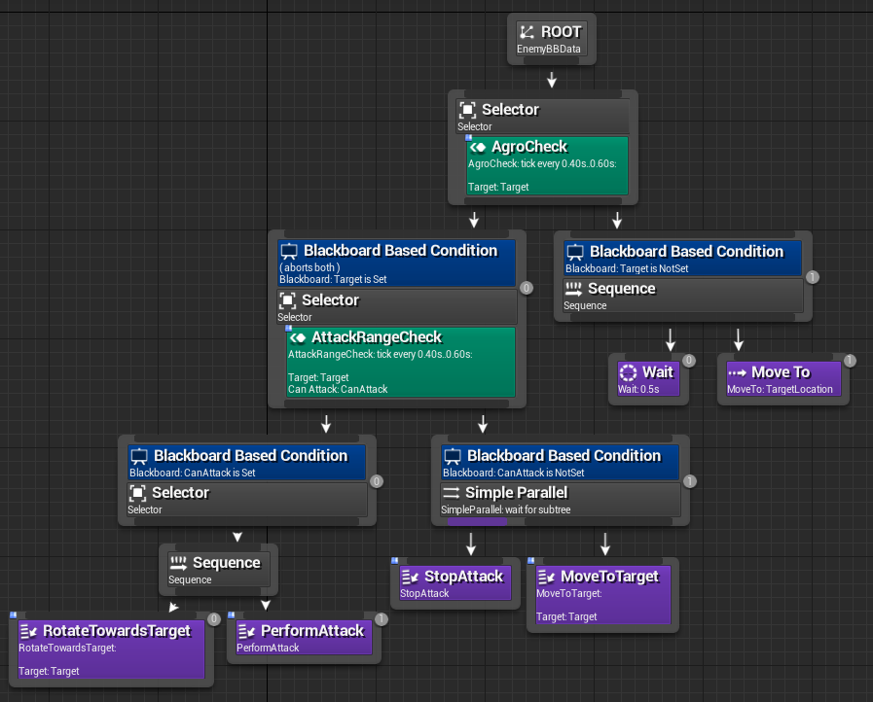
Behaviour Trees in UE4
While state based systems can be implemented easily using Blueprint, UE4 ships with an inbuilt Behaviour Tree editor for handling AI solutions.
UE4’s Behaviour Tree editor is a node based representation of standard coded behaviour trees with some differences.

Slide 12
Behaviour Trees – Node Types
Root - The start execution node for the Behaviour Tree. Every Behaviour Tree has one. It can only have one connection, and you cannot attach Decorators or Services to it.
Composite - These are the nodes that define a branch and control the base rules for how that branch is executed.
Decorator - Also known as conditionals. These attach to another node and make decisions on whether or not a branch in the tree, or even a single node, can be executed. They attach to Composite nodes.
Service - These attach to Composite nodes, and will execute at their defined frequency as long as their branch is being executed. These are often used to make checks and to update the Blackboard. These take the place of traditional Parallel nodes in other Behaviour Tree systems.
Task - These are the leaves of the tree, the nodes that direct the agent.

Slide 13
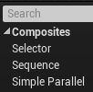
Composite Nodes
Composite Nodes define a branch on the tree. They can have both Decorators and Services attached to them:
Decorators modify entry into the branch.
Services will only execute if the children of the Composite are being executed when the branch is exited.
Logic flow is decided depending on the type of Composite that is used. In UE4 there are three to choose from:

Slide 14
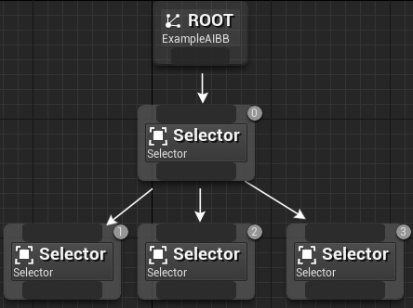
Composite - Selector
Selector composites execute their children from left to right, and will fail when one of their children fails. When a Selector's child succeeds the Selector succeeds.
A Selector is essentially the finder of the successful branch.
Selectors work well in conjunction with Decorators to find the successful Branch.
Succeed
Fail
Succeed
Not Run

Slide 15
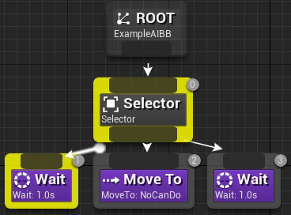
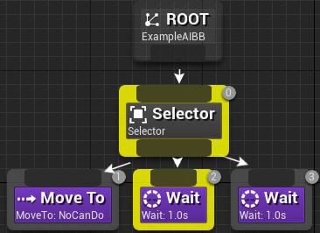
Composite - Selector
If we consider the first example on the right:
The root will fire, then the selector.
The Selector reads the tasks from left to right.
The first one is wait.
‘Wait’ can’t really fail – so it’s successful.
It returns to the Selector above it. ‘MoveTo’ will never fire because the wait was successful.
The second example will try to move towards something. If it can’t then it will return to the Selector, which will move to the first Wait node. This will succeed.
You will notice that the Selector keeps trying to move the AI, before it moves onto the Wait node

Slide 16
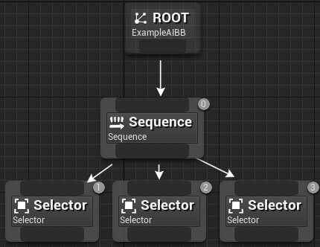
Composite - Sequence
Sequence composites execute their children from left to right, and will fail when one of their children returns Fail. When all a Sequence’s children succeed, it succeeds successfully.
Sequences are used when it is essential that all Branches connected to it must executed successfully.
Fail
Fail
Succeed
Fail

Slide 17
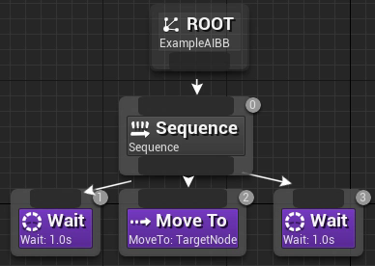
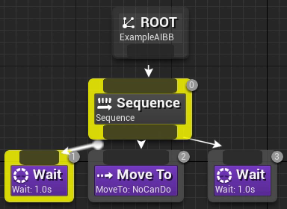
Composite - Sequence
Wait = Successful
Continues execution to ‘MoveTo’, which fails
The Sequence ‘fails’
Root starts again
Wait = Successful
Returns to Selector (which is Successful)
Root starts again
Wait = Successful
Continues execution to ‘MoveTo’, which is successful
Continues execution to ‘Wait’, which is successful
Root starts again

Slide 18
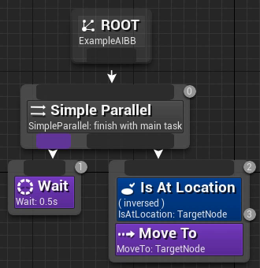
Composite – Simple Parallel
The Simple Parallel composite allows a single main task node to be executed along side of a full tree. When the main task finishes, the setting in Finish Mode (Details Panel) dictates if the node should finish Immediately, aborting the secondary tree, or if it should Delay for the secondary tree to finish.

Slide 19
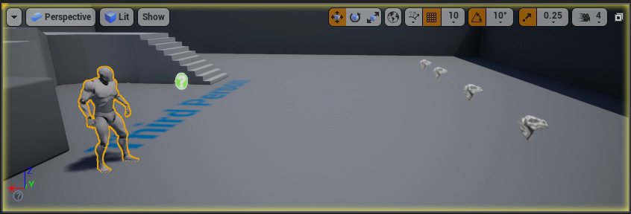

Immediate vs Delayed of the previous example:

Slide 20
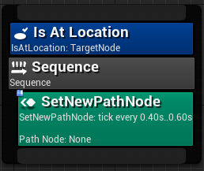
Services
Services attach to Composites (not Tasks) and are used to update data in some way.
This is often used to make checks by preparing data for a condition (Decorator).
An example of this may be to check if the AI can see an enemy (more on this next week).
If it can, this is updated in the Blackboard asset and checked against using a Decorator (condition).
More than one Service can be attached to a single Composite.

Slide 21
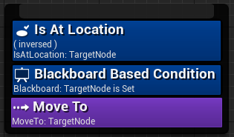
Decorators
Decorators can be attached to Composites or Tasks and are used as conditionals.
These are used to control transversal through the branches of the Behaviour Tree.
If a Decorator Succeeds logic can transition along its Branch.
Common Decorators:
Blackboard decorator which will check to see if a value is set on the given Blackboard Key.
Compare Blackboard Entries is used to compare the values of two Blackboard keys.
More than one Decorator can be attached to a Composite or a Task.

Slide 22
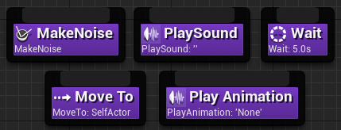
Tasks
Tasks are the leaves of the tree, they instruct the AI controlled Agent to take some form of action.
Leaf Nodes can return if they have succeeded or fail, which informs the Composites what to do next.
The Behaviour Tree Editor comes with some in built tasks available to use, such as Move To, which causes the controlled pawn to move to a provided vector using the NavMesh. Custom nodes can be built to suit specific needs.
Being the leaves of the tree, they cannot have any children. This means that they cannot have Services attached to them, however they can make use of Decorators.

Slide 23
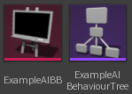
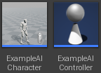
Assets Related to Behaviour Trees in UE4
Within UE4 there are two assets that are essential in order to create any properly function AI Behaviours:
Behaviour Tree Asset – The Behaviour Tree is the AI’s processor. It makes and acts on decisions. It is pure logic flow.
Blackboard Asset – The Blackboard is the AI’s Memory. It stores key values for the Behaviour Tree to use.
AI Controller – A Controller specific to AI. They can run Behaviour Trees.
Character – Not all AI requires a Character Pawn to possess (AI Director), but it is normal to have one.

Slide 24
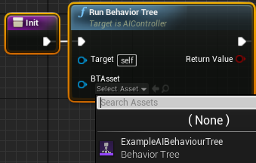
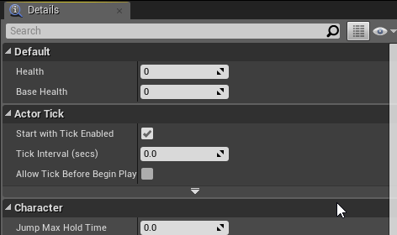
AI Controller & Character Assets
AI Controller:
Parent class = AIController.
AI Controllers are very similar to Player controllers apart from they are not directed using an Input Device / Manager, and are instead directed using a Behaviour Tree.
They can still Possess/Un-possess a Character.
Can run a Behaviour Tree (using the Run Behaviour Tree node).
Character:
Parent Class = Character / Pawn.
No difference from a standard Character.
Does not require anything involving a camera.
AI Controller is set in the class defaults in the details panel (search “AI”).
Auto Possess AI indicates when the AI Controller class provided should possess this Character.

Slide 25
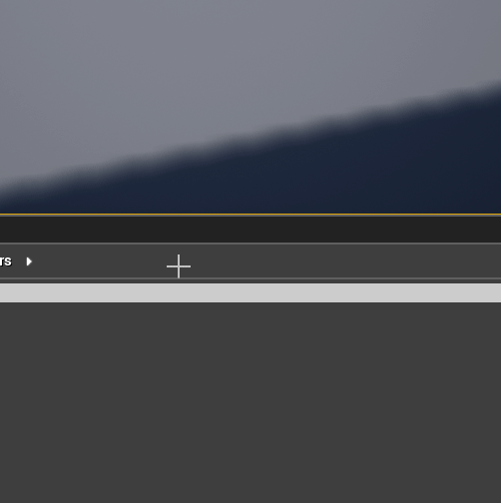
Behaviour Tree Asset
Behaviour Tree Assets can be created by right clicking in the Content folder and navigating towards the Artificial Intelligence section and selecting Behaviour Tree.
Alone a Behaviour Tree won’t do much. It must be ran by an AI Controller.
To do so, use the Run Behaviour Tree node within an AI Controller. This is usually done from an Init function.

Slide 26

Custom Behaviour Tree Nodes
You can create your own custom Services, Decorators and Tasks from within a Behaviour Tree.
Be aware that when you do this a new window will open with a pre-defined name.
Make sure that you go back into the Content Browser and change this (see next slide).
For Tasks, you must define a parent – Unless otherwise required the default BTTask_BlueprintBase is fine.

Slide 27
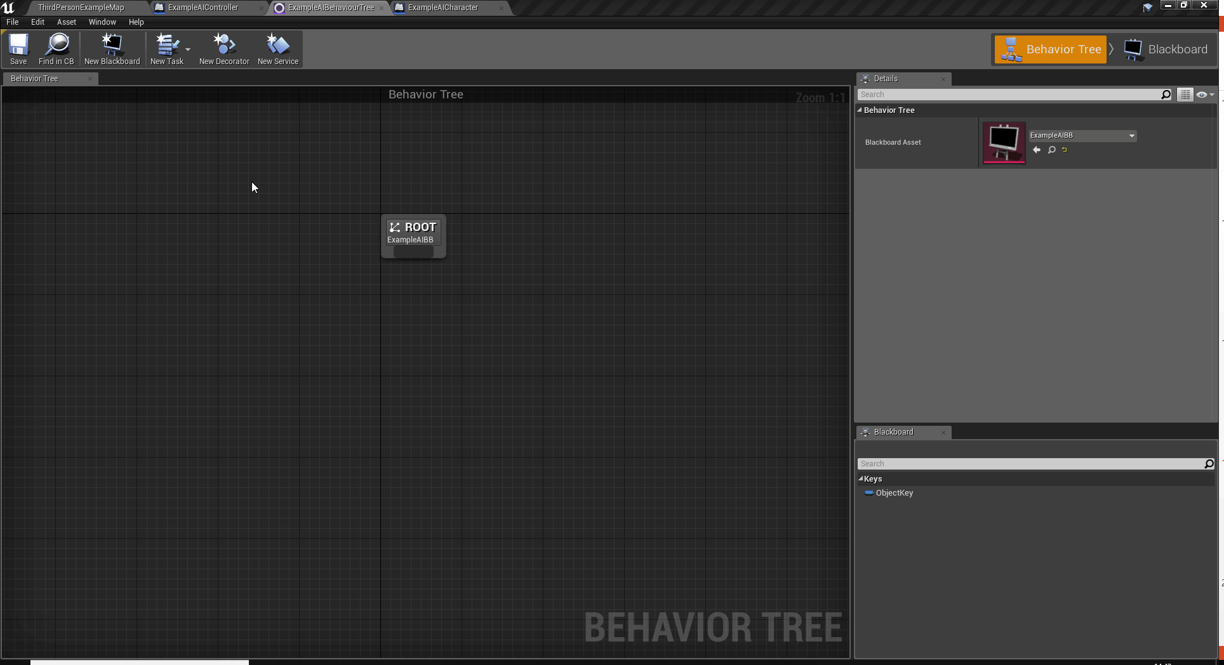
Custom Behaviour Tree Nodes

Slide 28
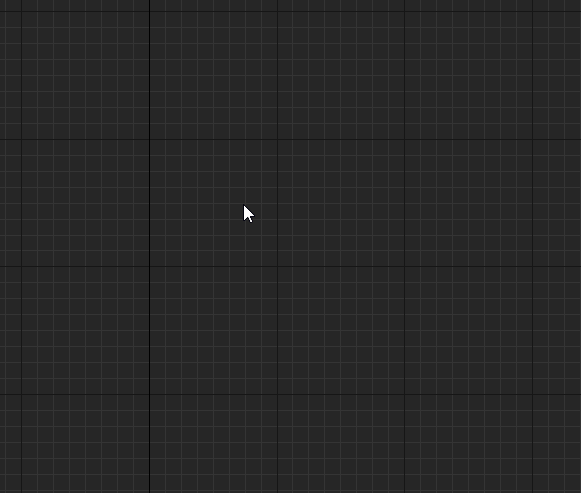
Adding Nodes to a Behaviour Tree
Tasks / Composites – Right click and find the required node.

Slide 29
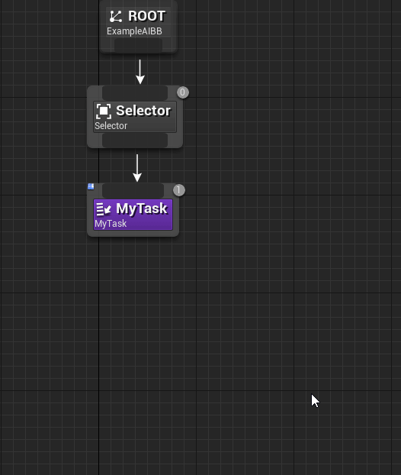
Adding Nodes to a Behaviour Tree
Decorators / Services – Right click the node you wish to attach to and select the required node.
Remember that Services cannot be attached to Tasks!

Slide 30
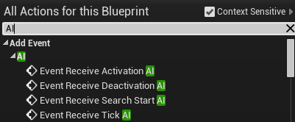
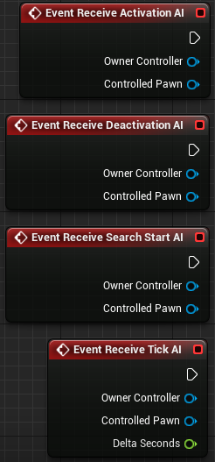
Blueprint - Service
As stated previously, Services are often used to update information.
The Blueprints themselves make use of a number of Events to function properly.
Receive Activation AI – Service becomes active.
Receive Deactivation AI – Service becomes inactive.
Receive Search Start AI – Execution enters this branch of the tree.
Receive Tick – AI version of tick.
When using these Events, make sure that you use the AI versions and not the standard ones (they provide Controller & Pawn references).

Slide 31
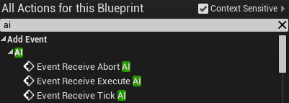
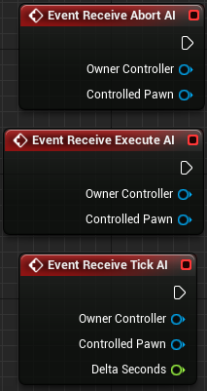
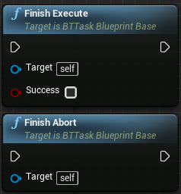
Blueprint - Tasks
Tasks are similar to Services in that they use AI Events as the primary means to execute.
Abort AI – When the Task is aborted.
Receive Execute AI – Entry point, will execute when the task is reached in the Behaviour Tree.
Receive Tick AI - AI version of tick.
One other thing that Tasks must do is call Finish:
Finish Execute – Finishes task execution with Success or Fail.
Finish Abort – Aborts the Task.
If a version of finish is not called, the AI will continue executing the Task forever and control will not pass back to the Behaviour Tree.

Slide 32
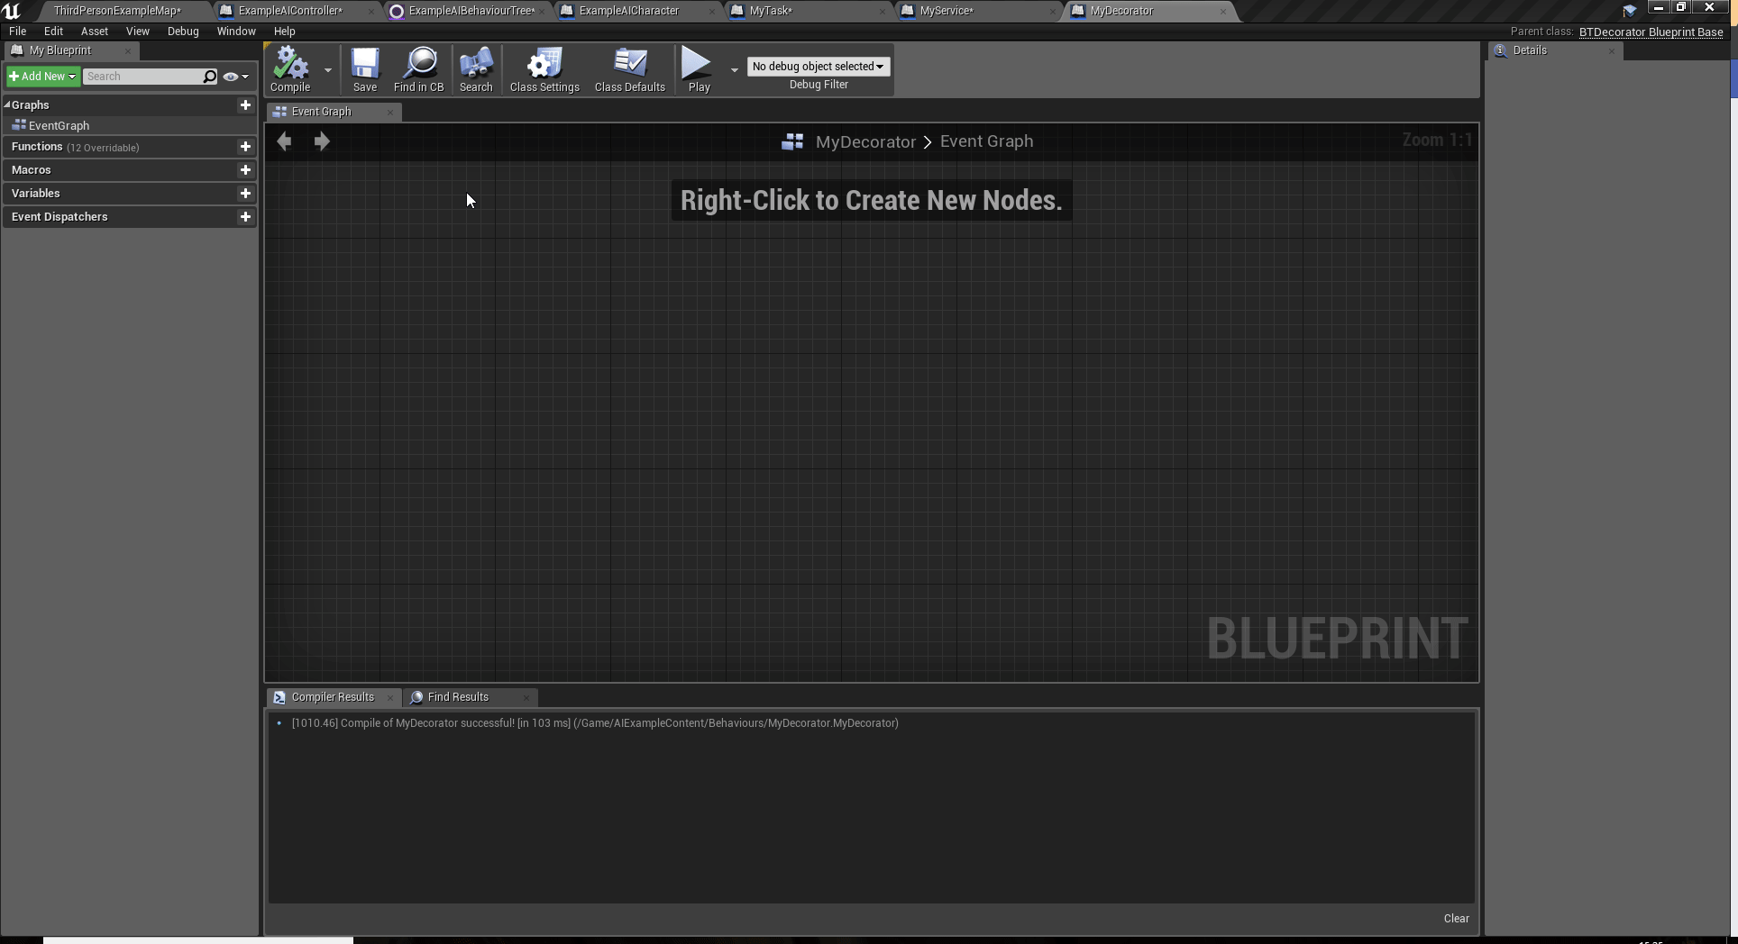
Blueprint - Decorator
As conditionals, Decorators behave a little differently from Tasks and Services.
Instead of running logic via an Event, a function is used that returns a Boolean value to determine if the Decorator should succeed or fail.

Slide 33
Handling Data – Blackboard Asset
We’ve seen how the flow of logic through a Behaviour Tree can be controlled by setting data (Services) and testing it using conditionals (Decorators).
With this in mind, we know that this data must be stored somewhere. Where could this be done?
The Service / Decorator / Task is the obvious choice, however this means that a lot of data must be passed around between assets.
Not the best of things seeing as though Behaviour Tree’s usually update fairly often and contain many different nodes.
Find Enemy Service
Is Enemy In Range Decorator
Attack Enemy Task

Slide 34
Handling Data – Blackboard Asset
In UE4, the data used for Behaviour Trees is stored using an asset called a Blackboard Asset.
Blackboards are used to centralize data and remove the need for extra logic about the data sender.
Without this, a number of steps will have to be taken to query information that may be stored in various different classes.
Think of it like a box that stores information used by the Behaviour Tree.
Data is stored in Blackboard Assets using Blackboard Keys.
Find Enemy Service
Blackboard Asset:
Best Enemy
Flee Location
Closest Pick Up
Is Enemy In Range Decorator
Attack Enemy Task

Slide 35
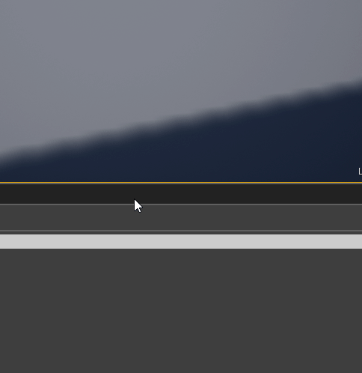
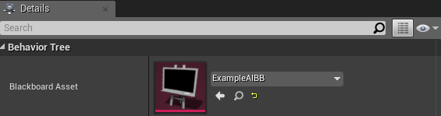
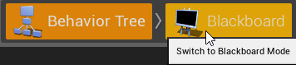
Blackboard Asset
Behaviour Tree Assets can be created by right clicking in the Content folder and navigating towards the Artificial Intelligence section and selecting Blackboard.
In order to link a Blackboard to a Behaviour Tree you must open the Behaviour Tree and in its Details Panel search for the Blackboard Asset you wish to use.
With the two Assets linked, you can now navigate to the Blackboard Mode to start creating Keys (data).

Slide 36
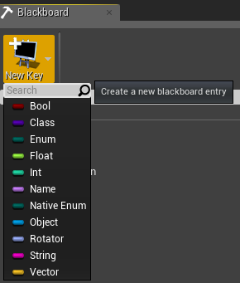
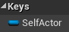
Blackboard Asset – Keys
Keys of various different types can be created within the Blackboard asset.
These Keys support most of the standard data types.
In order to Create a Key simply click the New Key button in Blackboard Mode.
You will see a SelfActor key already created for you in most Blackboards. This is a reference to the Pawn controlled by this Behaviour Tree. You can delete this if you wish.

Slide 37
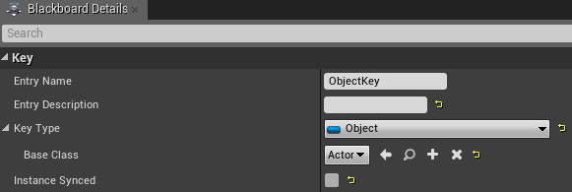
Blackboard Asset – Keys
When you have created some Keys you will notice that with one selected you can access its Details within the Details Panel.
Key things to keep in mind:
Instance Synced – Whether this Value is replicated across all Blackboards of this type. This basically means that if you spawned two of the same AI that this Key will be updated for both each time it is set. Useful for squad based AI.
Base Class – Only relevant to Objects. This can be set to be a specific object class. Keep in mind that if you want to use this for Transform data in any way (e.g. Moving / Navigation) it will have to be of at least type Actor as it defines a Transform.

Slide 38
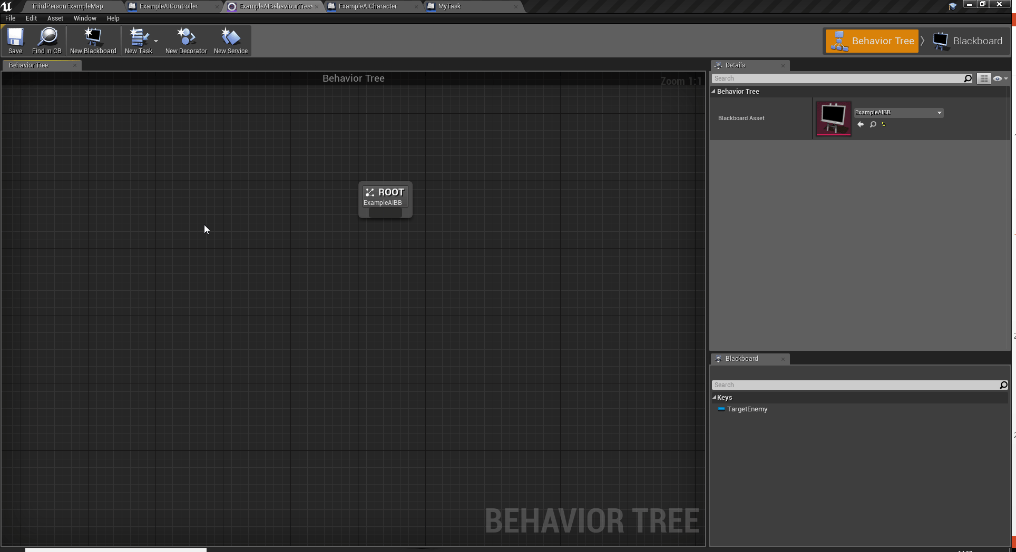
Accessing Keys – Behaviour Tree
Once you have created the keys you wish to use you can use them in conjunction with a number of different Behaviour Tree nodes in the Behaviour Tree itself.

Slide 39
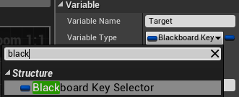

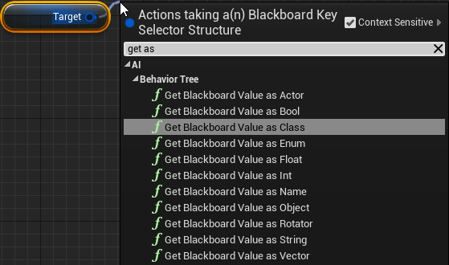
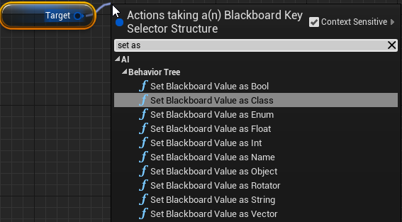
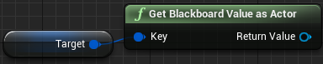
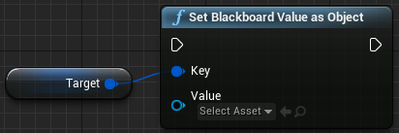
Accessing Keys – Behaviour Tree Nodes
In order to access / change a Blackboard key from within a Behaviour Tree node you must first create a variable of type BlackboardKeySelector and ensure that it is Editable (click the eye icon so that it is open).
With this created, you can drag off of this variable to Get / Set the value of the key using Get / Set BlackboardValueAs”DataType”.

Slide 40
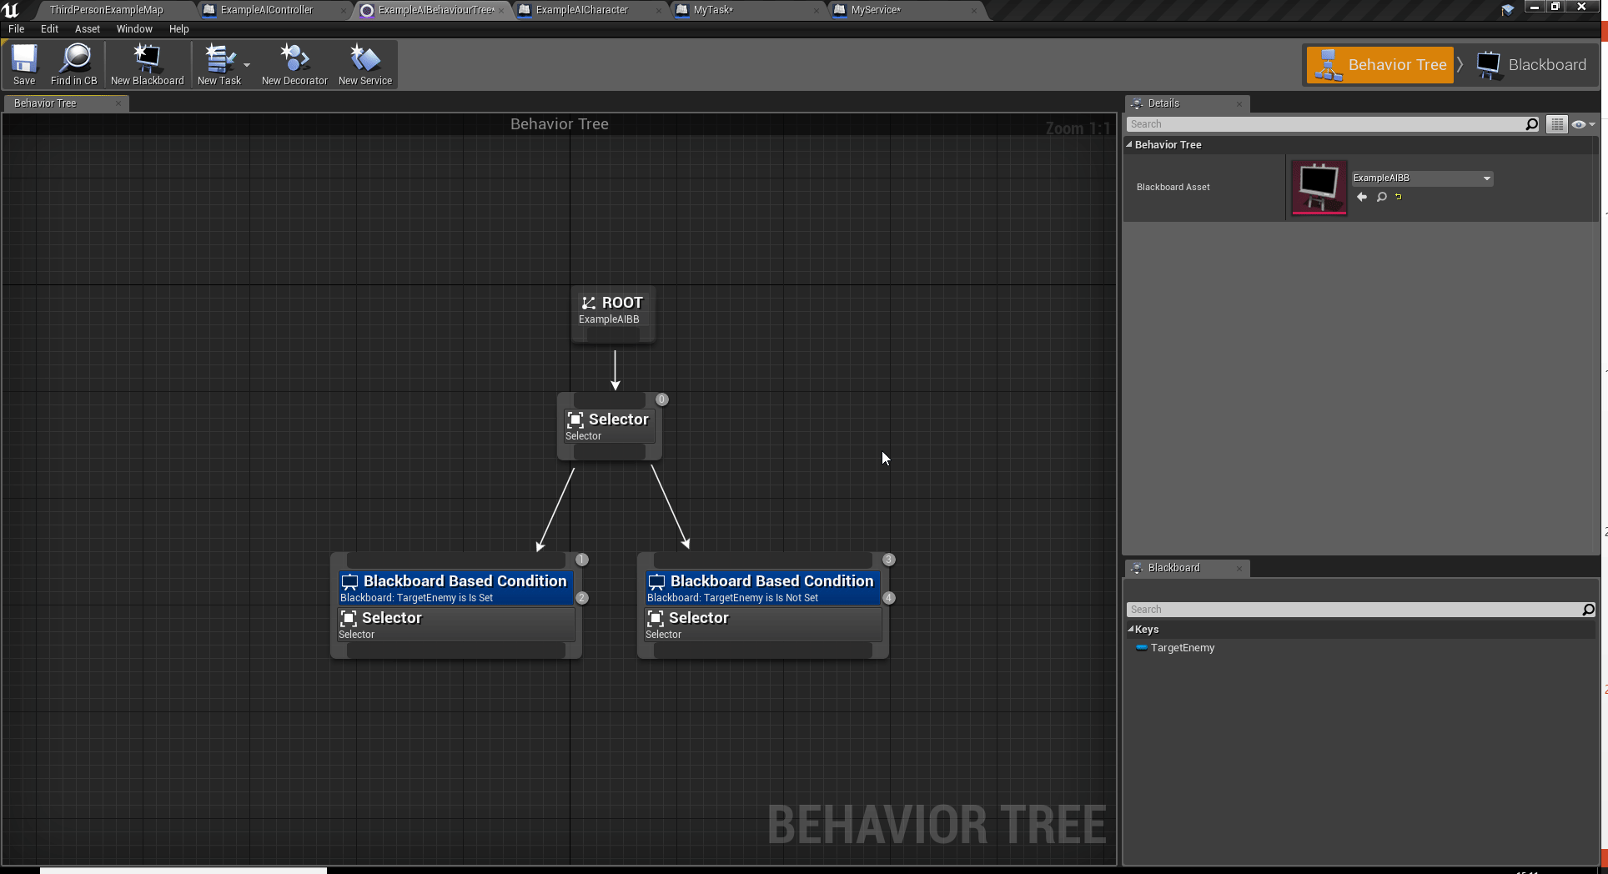
Accessing Keys – Behaviour Tree Nodes
Editable Blackboard Key selectors can be accessed from the Behaviour Tree in the same way as used previously.

Slide 41
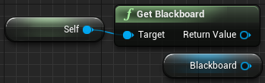
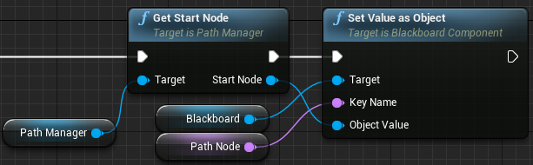
Accessing Keys – Outside of Behaviour Trees
In order to access the Blackboard from outside of a Behaviour Tree node (e.g. from within the AIController), you must first access the Blackboard in question.
This is done from within the AIController using the Get Blackboard node, or simply the variable named Blackboard.
From here you can access the Get / Set BlackBoard Keys using the GetValueAs”DataType”, and SetValueAs”DataType” nodes.
Notice how the key is accessed using a Name type.

Slide 42
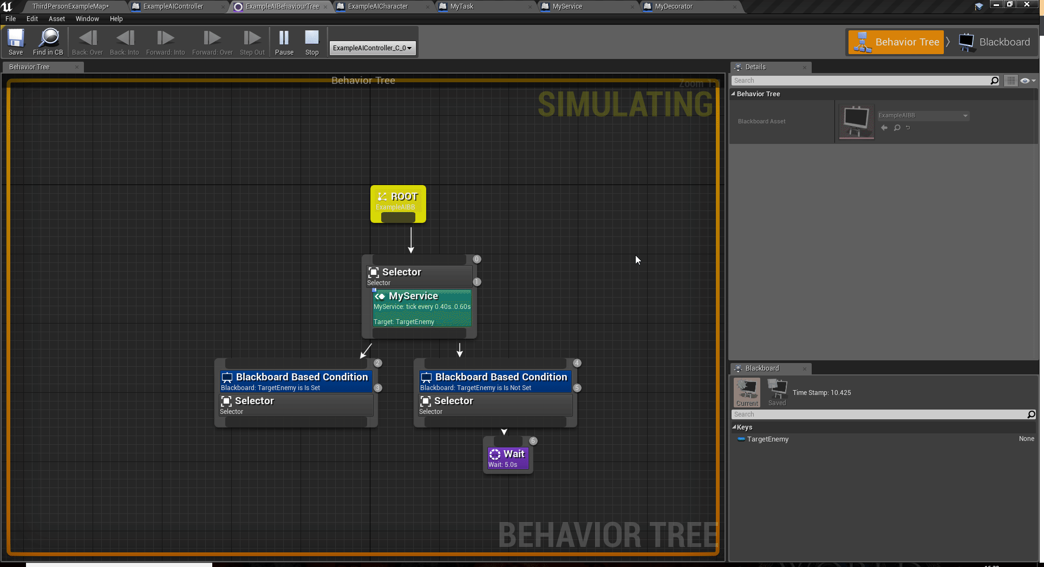
Debugging
While there are many ways to debug AI, its normally best to test in an isolated case.
You can use the tools you looked at in previous weeks to test individual Agents using the debug filter.
Pay close attention to the Blackboard tab to check if Keys have been set, and what to.

Slide 43
Final Thoughts
We’ve been over an introduction to Behaviour Trees and how they work within the Unreal Engine.
Next week we’ll be looking a how an AI can perceive the world around it in order to create more interesting Behaviours.

Slide 44
Forum Post Suggestions & Your Work
Make sure to keep updating the forum posts.
Consider the design of your AI:
What Tasks will need to be created?
What Data is required to be created in the Blackboard Asset?
What Services and Decorators need to be created to set and check this data?
Are you spawning enemies from a spawned class or will they be placed in the world?
Thinking about next weeks lesson:
How will it perceive the world around it?
Sight
Awareness

Slide 45
For Next Week
On Blackboard is a shell project that contains everything you need to create an AI Agent that follows a set of path nodes that are place within the level.
There is also a written guide as to how to create a working version of the desired behaviours.
Make sure you pick this up and give it a go for next week !

Slide 46
Cool Reads
Finite State Machines: Theory & Implementation
Unreal Engine Documentation – Behaviour Tree Nodes
Unreal Engine Documentation – How Unreal Behaviour Trees Differ from Traditional Trees

Slide 47
Any Questions?
dominic.nash@staffs.ac.uk

